Slide 1
Python Deep Dive

Slide 2

Slide
Title: Python Deep Dive

Slide 3
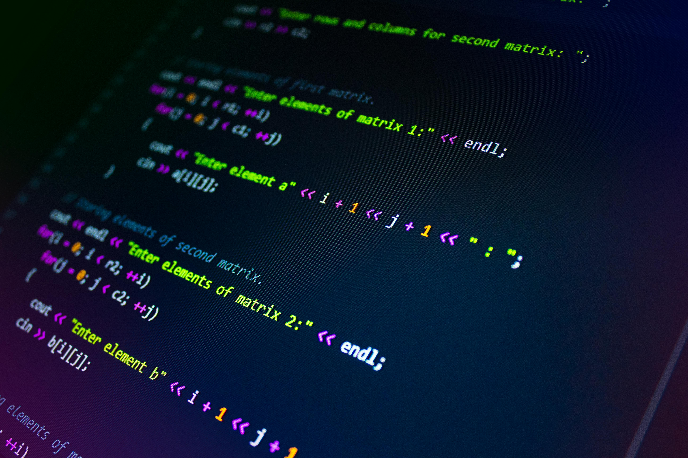
Introduction to Python
High-level, interpreted, general-purpose language
Significant indentation enforces readability
Dynamic typing offers flexibility
Widespread adoption in various domains

Slide 4

Core Language Features
Object-oriented programming (OOP) paradigm
Rich standard library for common tasks
Supports procedural and functional paradigms
Automatic memory management (garbage collection)

Slide 5

Package Management & Extensibility
Python Package Index (PyPI) hosts third-party libraries
`pip` simplifies installation and management
Web development with Django and Flask
Data science libraries (NumPy, Pandas, Matplotlib)

Slide 6

Advanced Python Concepts
Decorators modify function behavior
Introspection allows runtime object analysis
Comprehensions create data structures concisely
Generators for efficient data processing

Slide 7

Code Example
def decorator_example(func):
def wrapper(*args, **kwargs):
print("Before function call")
result = func(*args, **kwargs)
print("After function call")
return result
return wrapper
@decorator_example
def say_hello(name):
return f"Hello, {name}!"
print(say_hello("Alice"))

Slide 8
Code Example
def decorator_example(func): def wrapper(*args, **kwargs): print("Before function call") result = func(*args, **kwargs) print("After function call") return result return wrapper @decorator_example def say_hello(name): return f"Hello, {name}!" print(say_hello("Alice"))

Slide 9
Code Example
def decorator_example(func): def wrapper(*args, **kwargs): print("Before function call") result = func(*args, **kwargs) print("After function call") return result return wrapper @decorator_example def say_hello(name): return f"Hello, {name}!" print(say_hello("Alice"))

Slide 10
Performance and Interoperability
Global Interpreter Lock (GIL) limitations
Interaction with C/C++ for performance gains
Asynchronous programming with `asyncio`

Slide 11
Error Handling and Testing
`try...except` blocks handle exceptions
Testing frameworks (unittest, pytest)
Metaclasses for class creation control
Versatile language for diverse applications

